Slide 1
Lecture 2
Discrete versus Continuous Systems/Simulation

Slide 2
When time changes continuously and smoothly, the model is continuous. If time changes in incremental steps, the model is discrete. A discrete model is analogous to a movie. A sequence of frames moves so quickly that the viewer perceives motion. However, in a live play, the action is continuous. Just as a discrete sequence of movie frames represents the continuous motion of actors, we often develop discrete computer models of continuous situations .

Slide 3
Discrete system
State variables change instantaneously at separated point in time, e.g., a bank, since state variables - number of customers, change only when a customer arrives or when a customer finishes being served and departs

Slide 4
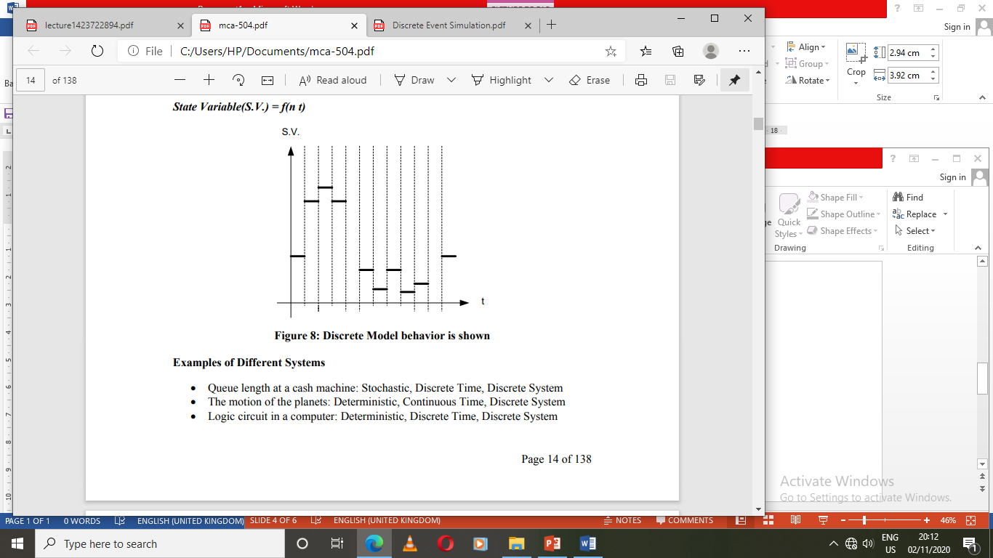
Discrete: State variables change at discrete points in time and generally numerical method like computational procedures is used to solve mathematical models. State Variable(S.V.) = f(n t)

Slide 5
Continuous system
State variable change continuously with respect to time, e.g., airplane moving through the air, since state variables - position and velocity change continuously with respect to time

Slide 6
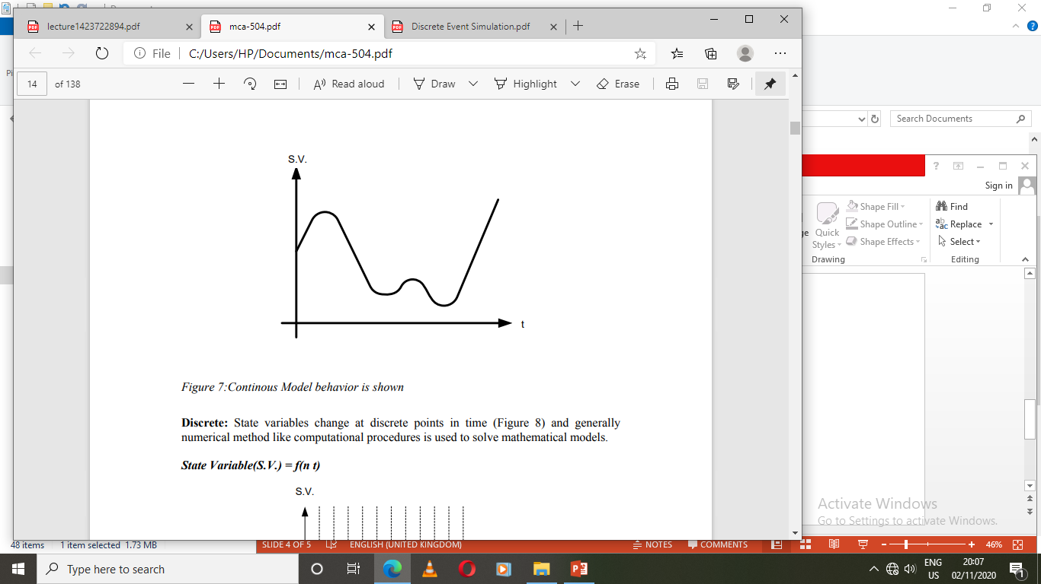
Continuous: State variables change continuously as a function of time and generally analytical method like deductive mathematical reasoning is used to define and solve the system. State Variable (S.V.) = f (t)

Slide 7
Discrete simulation
We now that simulation is of two types (time advance)
Continuous Simulation and
Discrete Simulation.
What is Discrete Simulation?
“The technique of imitating the behaviour of some situation or system (Economic, Mechanical etc.) by means of an analogous model, situation, or apparatus, either to gain information more conveniently or to train personnel."

Slide 8
In some systems the state changes all the time, not just at the time of some discrete events. For example, the water level in a reservoir with given in and outflows may change all the time. In such cases "continuous simulation" is more appropriate, although discrete event simulation can serve as an approximation. When the number of events is finite, we call the simulation "discrete event." Discrete event Simulation is a powerful computing technique for understanding the behavior of systems. The particular nature of the system and the properties we wish to understand can vary. Here are three examples:

Slide 9
1. A natural scientist may be interested in a system of wolves and sheep, where the number of wolves changes with a constant birth rate and a death rate that is inversely proportional to the number of sheep, and the number of sheep changes with a constant birth rate and a death rate that is directly proportional to the number of wolves. The scientist would like to know the following: Do the number of wolves and the number of sheep stabilize in the long run, and if so to what values? Or do they vary cyclically, and if so with what period and phase?
2. A computer scientist may be interested in a system of jobs that circulate in a network of servers (e.g., CPU’s and I/O devices). The computer scientist would like to know whether a particular server is a ‘‘bottleneck’’, i.e., in the long run, is that server always busy while the other servers are mostly idle.
3. A classical system example is a queuing system with a single server. Here, customers arrive with certain service requirements, get served in some order, say first-comefirst-served, and depart when their service is completed. Note that a customer who arrives when the server is busy has to wait (in a queue). For this system, we would like to determine the average waiting time for customers, the average number of customers in the system, the fraction of time the server is busy, etc.

Slide 10
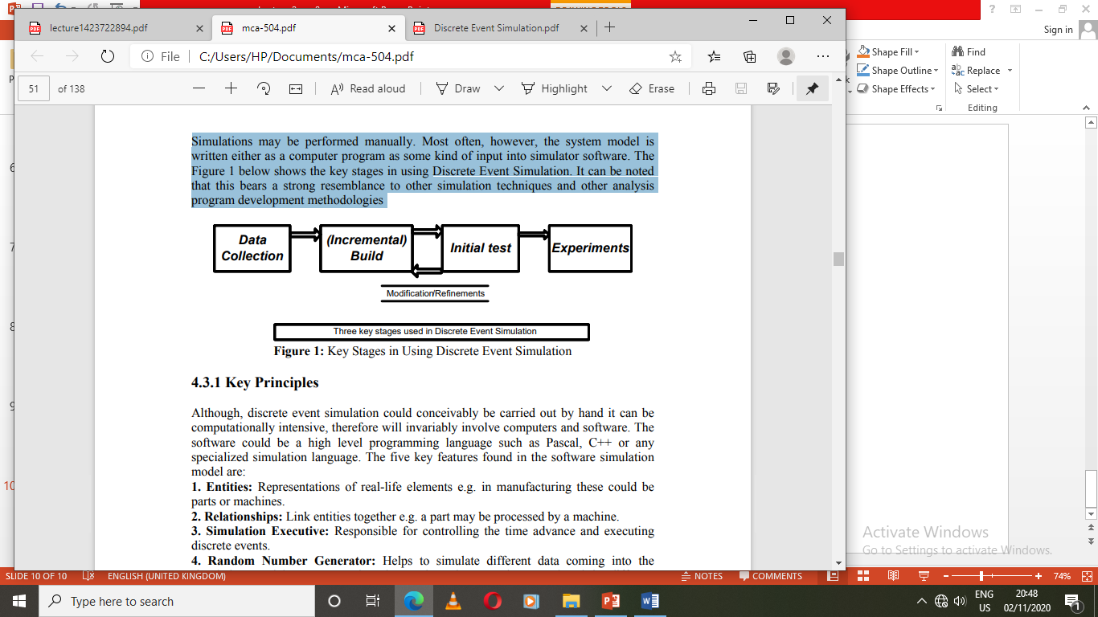
Simulations may be performed manually. Most often, however, the system model is written either as a computer program as some kind of input into simulator software. The figure below shows the key stages in using Discrete Event Simulation. It can be noted that this bears a strong resemblance to other simulation techniques and other analysis program development methodologies
Key Stages in Using Discrete Event Simulation

Slide 11
Key Principles
Although, discrete event simulation could conceivably be carried out by hand it can be computationally intensive, therefore will invariably involve computers and software.
The software could be a high level programming language such as Pascal, C++ or any specialized simulation language.

Slide 12
The five key features found in the software simulation model are:
1. Entities: Representations of real-life elements e.g. in manufacturing these could be parts or machines.
2. Relationships: Link entities together e.g. a part may be processed by a machine.
3. Simulation Executive: Responsible for controlling the time advance and executing discrete events.
4. Random Number Generator: Helps to simulate different data coming into the simulation model. Important that the random data can be reproduced in different simulation runs.
5. Results & Statistics: Important in validating the model and for providing performance measures.

Slide 13
There are also three approaches to describing the discrete simulation.
1. Event: This approach describes an instantaneous change, usually from a stop event to a start event. This is the most common one used, easy to understand and efficient and is acceptable to implement.
2. Activities: Represents duration. Essentially groups a number of events in order to describe an activity carried out by an entity e.g. a machine loading. This approach is easy to understand and to implement but is not efficient.
3. Process: This approach groups activities to describe the life cycle of an entity e.g. a machine. This is less common and more difficult to plan and implement, but is generally thought to be the most efficient.

Slide 14
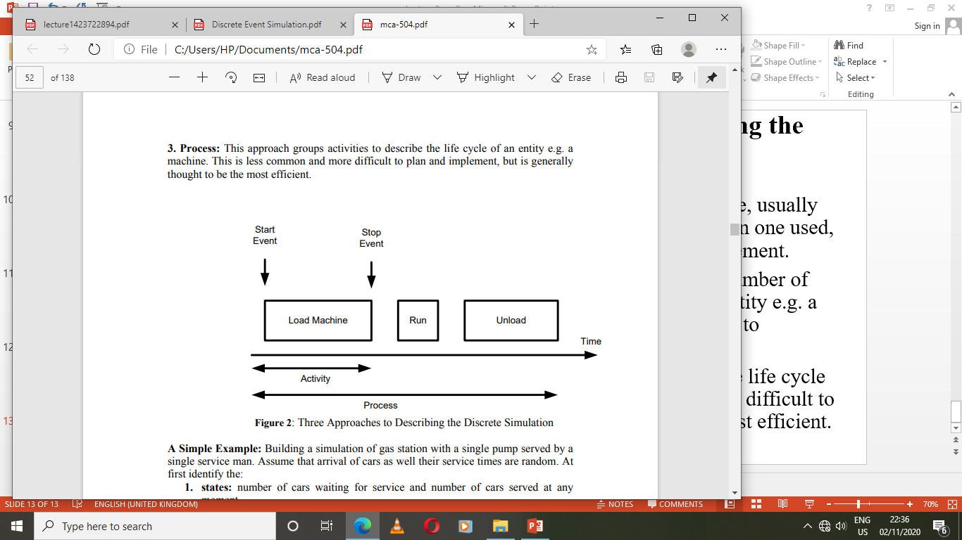
There are also three approaches to describing the discrete simulation cont’

Slide 15
A Simple Example: Building a simulation of gas station with a single pump served by a single service man. Assume that arrival of cars as well their service times are random. At first identify the:
  States: number of cars waiting for service and number of cars served at any moment
  Events: arrival of cars, start of service, end of service
  Entities: these are the cars
  Queue: the queue of cars in front of the pump, waiting for service
  Random realizations: inter-arrival times, service times
  Distributions: we shall assume exponential distributions for both the inter-arrival time and service time.

Slide 16
Next, specify what to do at each event. The above example would look like this: At event of entity arrival: Create next arrival. If the server is free, send entity for start of service. Otherwise it joins the queue. At event of service start: Server becomes occupied. Schedule end of service for this entity. At event of service end: Server becomes free. If any entities waiting in queue: remove first entity from the queue; send it for start of service. Some initiation is still required, for example, the creation of the first arrival. Lastly, the above is translated into code. This is easy with an appropriate library, which has subroutines for creation, scheduling, and proper timing of events, queue manipulations, random variable generation and statistics collection.

Slide 17
Interaction of the Principle and Interest
Discrete simulation is a technique where the simulation is advanced from event time to event time rather than using a continuously advancing time clock as in continuous simulation. Suppose we consider the example of the interaction of the principle and interest associated with a savings account. This can be represented by a systems thinking diagram

Slide 18
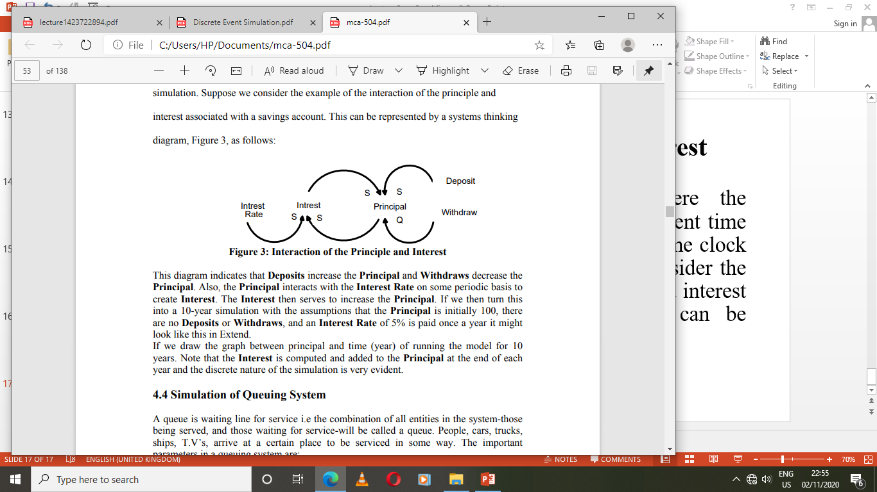
Interaction of the Principle and Interest

Slide 19
This diagram indicates that Deposits increase the Principal and Withdraws decrease the Principal. Also, the Principal interacts with the Interest Rate on some periodic basis to create Interest. The Interest then serves to increase the Principal. If we then turn this into a 10-year simulation with the assumptions that the Principal is initially 100, there are no Deposits or Withdraws, and an Interest Rate of 5% is paid once a year it might look like this in Extend. If we draw the graph between principal and time (year) of running the model for 10 years. Note that the Interest is computed and added to the Principal at the end of each year and the discrete nature of the simulation is very evident.

Slide 20
DISCRETE-EVENT SIMULATION
A discrete-event simulation - models a system whose state may change only at discrete point in time.
System - is composed of objects called entities that have certain properties called attributes
State - a collection of attributes or state variables that represent the entities of the system.
Event - an instantaneous occurrence in time that may alter the state of the system
An event initiates an activity, which is the length of time during which entities engage in some operations Entities, attributes, events, activities and the interrelationships between these components are defined in the model of the system

Slide 21
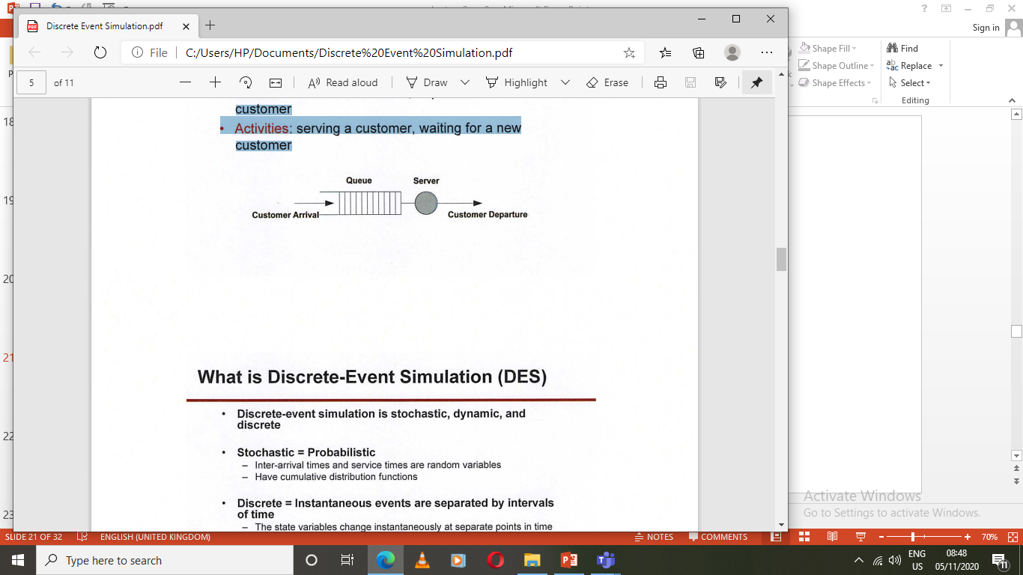
Example: A Single Server System
Entities: customers; server
Attributes of a customer: service required
Attributes of server: server's skill (its service rate)
Events: arrival of a customer; departure of a customer
Activities: serving a customer, waiting for a new customer

Slide 22
Applications of discrete event simulation:
• It is used by operation research workers to study large complex systems which cannot be studied by analytical method.
• In inventory control.
• Study of sea and airport.
• Steel melting stuffs.
• Telephone exchanges.
• Production line.
• Project scheduling etc.

Slide 23
Continuous Simulation Language
Continuous simulation languages developed in late fifties as simulators of Analogue computers. Simulation on analogue computers is based on creating an analogue electronic system whose behavior is described by the same mathematical model (set of differential equations) as the system being investigated. The main problem of analogue computers is an analogue implementation of certain operations like multiplication, generation of some functions, generation of delays and others. Digital computers perform all these functions very easily and today continuous simulation is performed only on them. Nevertheless there is one operation where the analogue computers are better, which is integration. Digital computers use numerical integration that is generally slower and less accurate compared with the integration of an analogue integrator. Some special applications based on fast response use therefore the so-called hybrid computers that contain analogue and digital parts connected by Analog/Digital and Digital/Analog converters. The digital part does everything except integration. It computes inputs of integrators that converted by Digital/Analog converters to analogue signals inputted to analogue integrators. Their outputs are treated in the opposite way. The digital part also controls the interconnection of the analogue part that might thus change during computation.

Slide 24
Classification of Continuous Simulation Languages
Continuous simulation language can be classified in two ways, as
1. Block oriented simulation languages
2. Expression oriented continuous languages

Slide 25
Block Oriented Simulation Languages
Block oriented simulation languages are based on the methodology of analogue computers. The system must be expressed as a block diagram that defines the interconnection of functional units and their quantitative parameters. "Programming” means entering the interconnection of the blocks and their description. Then the user adds statements and/or directives that control the simulation. If the system is described as a set of equations, they must be converted to a block diagram. This conversion is a simple straightforward process. The typical blocks available in most continuous block oriented languages are integrators, limiters, delays, multipliers, constant values, adders, holders, gain (coefficient) and other.

Slide 26
Expression Oriented Continuous Languages
Expression oriented continuous languages are based on writing expressions (equations) that represent the mathematical model. So the system simulated must be expressed by a set of equations. Then the user adds statements and/or directives that control the simulation. Some languages enable both block and expression based ways of system definition. Simulation control means selection of the integration method (because some languages offer more), the integration step, the variables (outputs of blocks) that should be observed, the intervals for collecting data for printing and/or plotting, scaling of outputs (that may be also done automatically), duration of the simulation runs, number of repetitions and the way certain values are changed in them. Models are created using a simple continuous simulation environment based on Expression oriented approach and can be easily modified to model any other systems described by differential equations.

Slide 27
Discrete Simulation Language
Discrete simulation deals with systems whose dynamics can be considered (due to the level of abstraction) as a sequence of events at discrete time points.
The key point of a discrete simulation language is the way it controls the proper sequencing of activities in the model. This is also the way a user must "view the world" when using the language and a base for classification of discrete simulation languages.

Slide 28
Classification of Discrete Simulation Languages
Flowchart Oriented Languages
Activity Oriented Languages
Event Oriented Languages
Process Oriented Languages

Slide 29
Flowchart Oriented Languages
Flowchart oriented languages are represented by the language GPSS (General Purpose Simulation System), that exists in many versions on various computers. The user must view the dynamics of the system as a flow of the so-called transactions through a block diagram. Transactions are generated, follow a path through a network of blocks, and are destroyed on exit. In blocks transactions may be delayed, processed, and passed to other blocks. Blocks are in the program represented by statements that perform the activities of the model.

Slide 30
Activity Oriented Languages
Activity oriented languages are not based on explicit scheduling of future activities. For each activity the user describes the condition under which the activity can take place (that also covers scheduling if the condition is reaching certain time). The algorithm of the simulation control repeatedly increments time and tests conditions of all activities. The disadvantage of this approach is obvious. It is necessary to evaluate all conditions in every step that may be very time consuming. On the other hand it is conceptually very simple and the algorithm can be easily implemented in general high-level languages (there are simulation languages based on this approach, but not widely used). The models of a simple queuing system that demonstrate the activity oriented approach. These models are accompanied by several units that implement operations on two way linked lists that are later used to implement stacks and queues.

Slide 31
Event Oriented Languages
Event oriented languages are based on direct scheduling and canceling of future event. The approach is very general. The user must view the dynamics of the system simulated as a sequence of relatively independent events. Every event may schedule and/or cancel another event. The system routine must keep record of scheduled events. That's why every event is represented by the so-called event notice that contains the time, the event type, and other user data. Event notices are kept in the so-called calendar, where the event notices are ordered by the scheduled time. After completion of an event routine, the system removes the event notice with the lowest time from the calendar, updates the model time by its time, and starts the corresponding routine. This is repeated until the calendar becomes empty or the program stops because of other reason. Scheduling means inserting event notices to the calendar by the scheduled time, canceling removes them. The approach based on explicit expressing of events is called Discrete Event Simulation that is sometimes generalized to discrete simulation as such. A typical representative of this group of languages is the language SIMSCRIPT.

Slide 32
Process Oriented Languages
Process oriented languages are based on the fact, that events are not independent. An event is typically a consequence of other previous events. In other words it is often possible to define sequences of events that may be viewed as entities of a simulation model at higher level of hierarchy. A sequence of events is called process. Unlike events process has a dimension in time. Process based abstract systems are very close to reality that is always made of various objects that exist and act in parallel interfering with each other. Process way of viewing system dynamics is thus very natural. Mostly a process models an activity of a real object. It is believed, that process oriented discrete simulation is the best way how to create discrete simulation models. Typical representatives of this group of languages are MODSIM, SIMSCRIPT II.5, and the system class SIMULATION of the Simula language.

